Slide 1

PROJECT OVERVIEW
EASY
ADVANCED

Slide 2

PROJECT CARD
GOAL:
Build, train, test and deploy a machine learning classifier model to predict diabetes in patients
TOOL:
AutoGluon
PRACTICAL REAL-WORLD APPLICATION:
This project can be effectively used by healthcare professionals to detect diabetes and understand key factors that contribute to the disease.
DATA:
INPUTS:
Pregnancies: Number of times pregnant
GlucosePlasma: glucose concentration a 2 hours in an oral glucose tolerance test
BloodPressure: Diastolic blood pressure (mm Hg)
Skin: ThicknessTriceps skin fold thickness (mm)
Insulin: 2-Hour serum insulin (mu U/ml)
BMI: Body mass index (weight in kg/(height in m)^2)
DiabetesPedigreeFunction: Diabetes pedigree function
Age: Age (years)
OUTPUT:
Diabetes or no diabetes (0 or 1)
Image Source: https://www.flickr.com/photos/pasa/6757993805
Dataset Source: https://www.kaggle.com/ljanjughazyan/cars1

Slide 3

PROJECT OVERVIEW
This dataset is used to predict whether or not a patient has diabetes, based on given features/diagnostic measurements.
Only female patients are considered with at least 21 years old of Pima Indian heritage.
Acknowledgements: Smith, J.W., Everhart, J.E., Dickson, W.C., Knowler, W.C., & Johannes, R.S. (1988). Using the ADAP learning algorithm to forecast the onset of diabetes mellitus. In Proceedings of the Symposium on Computer Applications and Medical Care (pp. 261--265). IEEE Computer Society Press.
Image Source: https://iconscout.com/icon/doctor-1659516

Slide 4
DATA OVERVIEW
The available features are:
Pregnancies: Number of times pregnant
GlucosePlasma: glucose concentration a 2 hours in an oral glucose tolerance test
BloodPressure: Diastolic blood pressure (mm Hg)
Skin: ThicknessTriceps skin fold thickness (mm)
Insulin: 2-Hour serum insulin (mu U/ml)
BMI: Body mass index (weight in kg/(height in m)^2)
DiabetesPedigreeFunction: Diabetes pedigree function
Age: Age (years)
Target (output):
Diabetes or no diabetes (0 or 1)
Acknowledgements
Smith, J.W., Everhart, J.E., Dickson, W.C., Knowler, W.C., & Johannes, R.S. (1988). Using the ADAP learning algorithm to forecast the onset of diabetes mellitus. In Proceedings of the Symposium on Computer Applications and Medical Care (pp. 261--265). IEEE Computer Society Press.

Slide 5
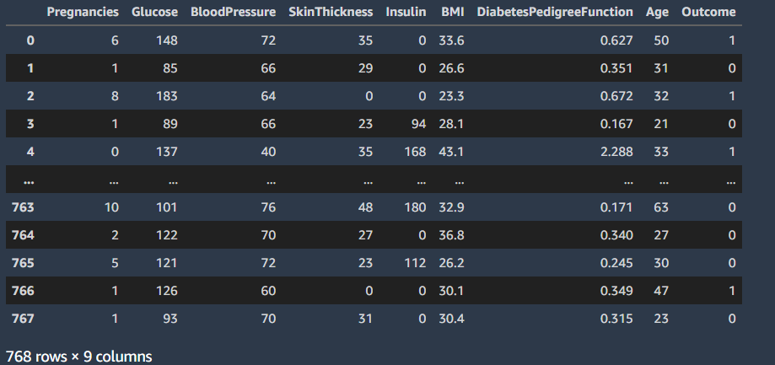
DATA OVERVIEW
TARGET CLASS

Slide 6
CLASSIFICATION MODELS KPIs [SKIP IF FAMILIAR]
EASY
ADVANCED

Slide 7
CLASSIFICATION MODEL KPIs
Classiﬁcation Accuracy = (TP+TN) / (TP + TN + FP + FN)
Misclassiﬁcation rate (Error Rate) = (FP + FN) / (TP + TN + FP + FN)
Precision = TP/Total TRUE Predictions = TP/ (TP+FP) (When model predicted TRUE class, how often was it right?)
Recall = TP/ Actual TRUE = TP/ (TP+FN) (when the class was actually TRUE, how often did the classiﬁer get it right?)
TRUE CLASS
+
-
+
TRUE +
FALSE +
PREDICTIONS
FALSE -
TRUE -
-

Slide 8
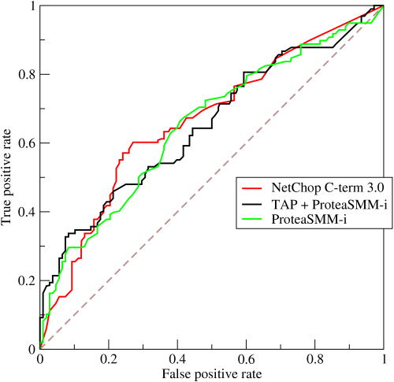
ROC (RECEIVER OPERATING CHARACTERISTIC CURVE)
ROC Curve is a metric that assesses the model ability to distinguish between binary (0 or 1) classes.
The ROC curve is created by plotting the true positive rate (TPR) against the false positive rate (FPR) at various threshold settings.
The true-positive rate is also known as sensitivity, recall or probability of detection in machine learning.
The false-positive rate is also known as the probability of false alarm and can be calculated as (1 − specificity).
Points above the diagonal line represent good classification (better than random)
The model performance improves if it becomes skewed towards the upper left corner.
Photo Credit: https://commons.wikimedia.org/wiki/File:Roccurves.png

Slide 9
AUC (AREA UNDER CURVE)
PREDICTOR #1
The light blue area represents the area Under the Curve of the Receiver Operating Characteristic (AUROC).
The diagonal dashed red line represents the ROC curve of a random predictor with AUROC of 0.5.
If ROC AUC = 1, perfect classifier
Predictor #1 is better than predictor #2
Higher the AUC, the better the model is at predicting 0s as 0s and 1s as 1s.
PREDICTOR #2
TRUE POSITIVE RATE
RANDOM PREDICTOR
FALSE POSITIVE RATE

Slide 10
AUTOGLUON REVIEW [SKIP IF FAMILIAR]
EASY
ADVANCED

Slide 11

AUTOGLUON 101
AutoGluon allows for quick prototyping of AI/ML models using few simple lines of code.
Autogluon works with text, image and tabular datasets.
No need for expert level knowledge to train/test AI/ML models in Autogluon.
Allows for automatic hyperparameters tuning and model selection.
Check this out: https://auto.gluon.ai/stable/index.html
All you need to do is to use these two lines of code!
Please note that hyperparameters and all other model training aspects are set to default.
Source: https://auto.gluon.ai/stable/tutorials/tabular_prediction/tabular-quickstart.html

Slide 12
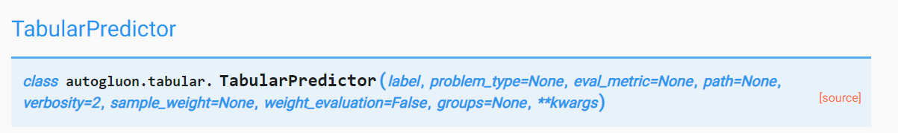
AUTOGLUON 101: TABULAR PREDICTOR PARAMETERS
Check these out:
https://auto.gluon.ai/stable/api/autogluon.task.html
https://auto.gluon.ai/stable/api/autogluon.task.html#autogluon.tabular.TabularPredictor.fit
Parameters:
Label: Name of the column that contains the target variable to predict
problem_type, type of prediction problem, i.e. is this a binary/multiclass classification or regression problem (options: ‘binary’, ‘multiclass’, ‘regression’, ‘quantile’). If problem_type = None, the prediction problem type is inferred based on the label-values in provided dataset.
eval_metric: test data metric, note that AutoGluon tunes hyperparameters and early-stopping to improve this metric on validation data.
If eval_metric = None, it is automatically chosen based on problem_type. Defaults to ‘accuracy’ for binary and multiclass classification, ‘root_mean_squared_error’ for regression, and ‘pinball_loss’ for quantile.
Otherwise, options for classification: [‘accuracy’, ‘balanced_accuracy’, ‘f1’, ‘f1_macro’, ‘f1_micro’, ‘f1_weighted’, ‘roc_auc’, ‘roc_auc_ovo_macro’, ‘average_precision’, ‘precision’, ‘precision_macro’, ‘precision_micro’, ‘precision_weighted’, ‘recall’, ‘recall_macro’, ‘recall_micro’, ‘recall_weighted’, ‘log_loss’, ‘pac_score’]
Options for regression:[‘root_mean_squared_error’, ‘mean_squared_error’, ‘mean_absolute_error’, ‘median_absolute_error’, ‘r2’]

Slide 13
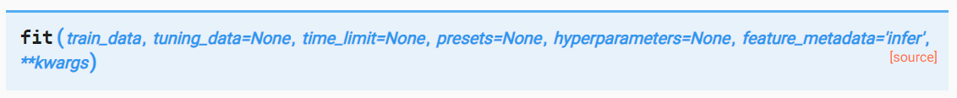
AUTOGLUON 101: FIT METHOD PARAMETERS
Fit models to predict a column of a data table (label) based on the other columns (features).
Parameters:
train_data: Table of the training data
tuning_data: validation data used for tuning processes such as early stopping and hyperparameter tuning. Don’t include test data here!
time_limit: how long fit() should run for in seconds. If not specified, fit() will run until all models have completed training.
Presets: default = [‘medium_quality_faster_train’]
List of preset configurations for arguments in fit().
Presets impact predictive accuracy, memory-footprint, and inference latency of trained models
As an example, to get the most accurate overall predictor (regardless of its efficiency), set presets=’best_quality’. To get good quality with minimal disk usage, set presets=[‘good_quality_faster_inference_only_refit’, ‘optimize_for_deployment’]
Available Presets: [‘best_quality’, ‘high_quality_fast_inference_only_refit’, ‘good_quality_faster_inference_only_refit’, ‘medium_quality_faster_train’, ‘optimize_for_deployment’, ‘ignore_text’]

Slide 14
AUTOGLUON 101: PRESETS
best_quality: Best predictive accuracy with little consideration to inference time or disk usage.
high_quality_fast_inference_only_refit: High predictive accuracy with fast inference. ~10x-200x faster inference and ~10x-200x lower disk usage than best_quality. Recommended for applications that require reasonable inference speed and/or model size.
good_quality_faster_inference_only_refit: Good predictive accuracy with very fast inference. ~4x faster inference and ~4x lower disk usage than high_quality_fast_inference_only_refit. Recommended for applications that require fast inference speed.
medium_quality_faster_train: Medium predictive accuracy with very fast inference and very fast training time. ~20x faster training than good_quality_faster_inference_only_refit. This is the default preset in AutoGluon, but should generally only be used for quick prototyping, as good_quality_faster_inference_only_refit results in significantly better predictive accuracy and faster inference time.
optimize_for_deployment: Optimizes result immediately for deployment by deleting unused models and removing training artifacts. Often can reduce disk usage by ~2-4x with no negatives to model accuracy or inference speed. This will disable numerous advanced functionality, but has no impact on inference. This will make certain functionality less informative, such as predictor.leaderboard() and predictor.fit_summary().

Slide 15
DEMO PART #1: CLASSIFICATION MODELS TRAINING USING AUTOGLUON
EASY
ADVANCED

Slide 16
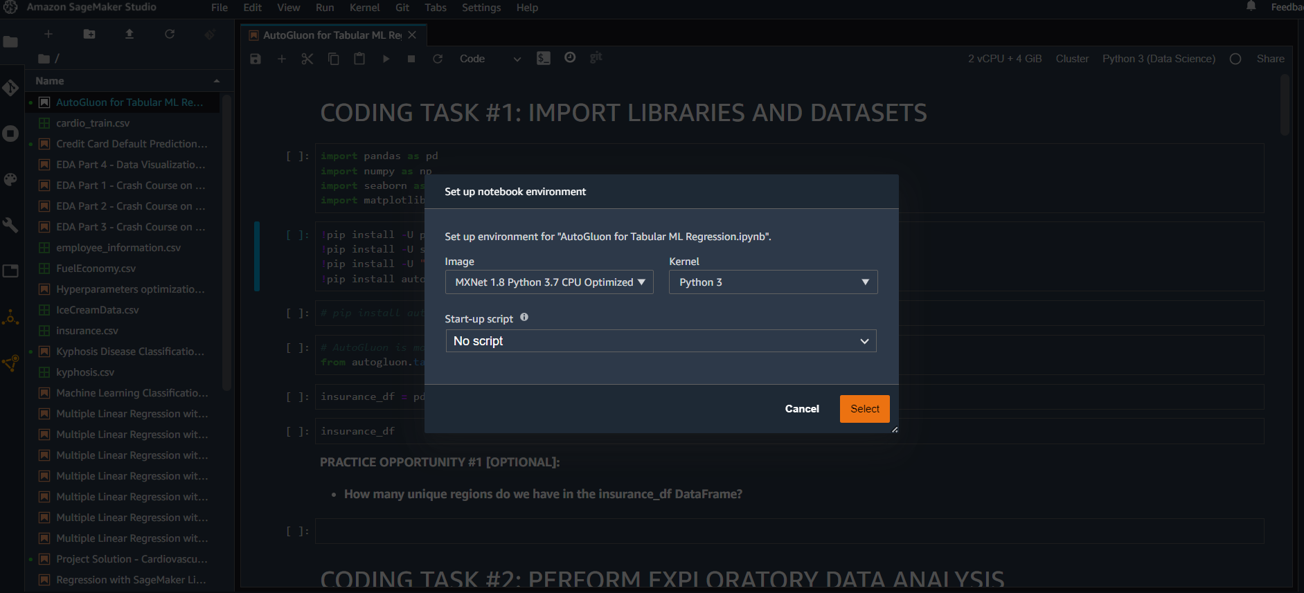
AUTOGLUON FOR CLASSIFICATION DEMO
CHOOSE THE IMAGE AND KERNEL SHOWN BELOW

Slide 17
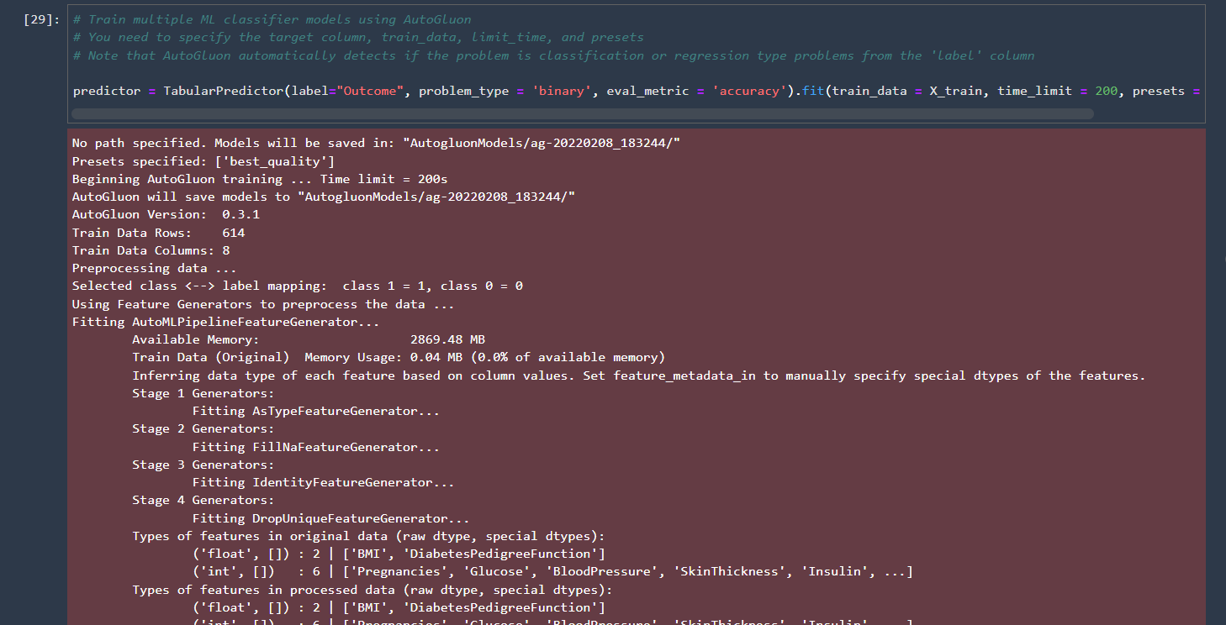
AUTOGLUON FOR CLASSIFICATION DEMO

Slide 18
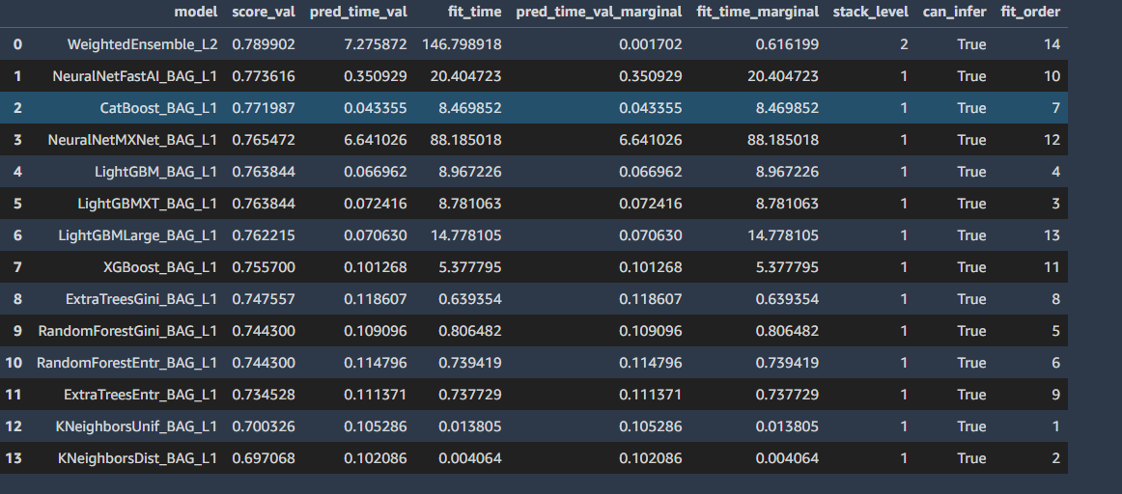
AUTOGLUON FOR CLASSIFICATION DEMO

Slide 19
DEMO PART #2: CLASSIFICATION MODELS EVALUATION USING AUTOGLUON
EASY
ADVANCED

Slide 20
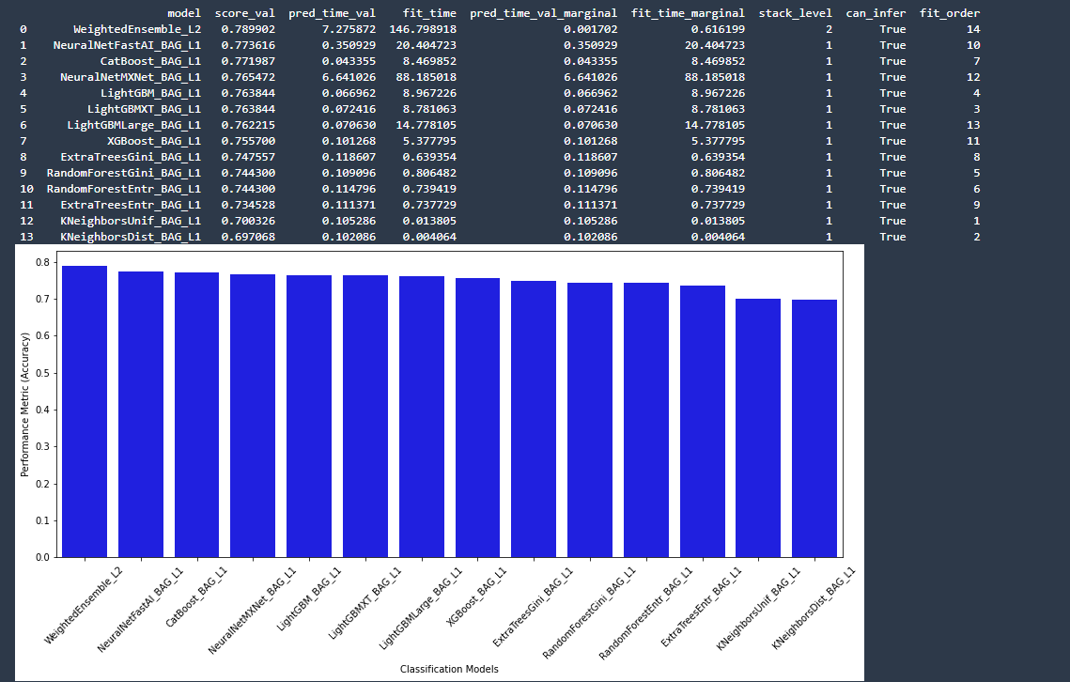
AUTOGLUON FOR CLASSIFICATION DEMO

Slide 21
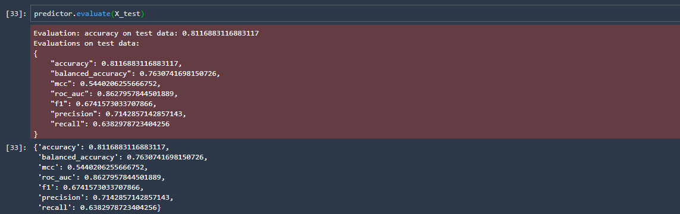
AUTOGLUON FOR CLASSIFICATION DEMO

Slide 22
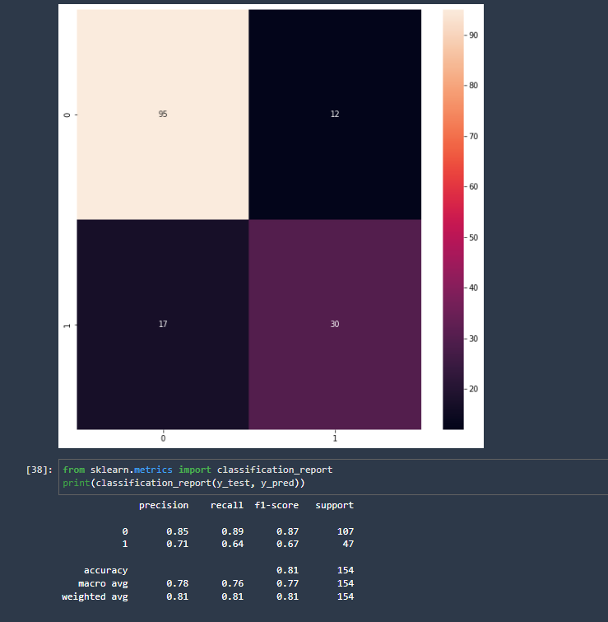
AUTOGLUON FOR CLASSIFICATION DEMO

Slide 23
FINAL END-OF-DAY CAPSTONE PROJECT
EASY
ADVANCED

Slide 24
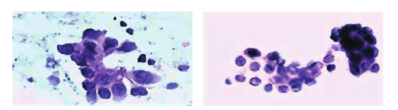
PROJECT OVERVIEW
Breast cancer is the most common cancer among women worldwide, accounting for 25% of all cancer cases and affected 2.1 Million people in 2015.
Early diagnosis significantly increases the chances of survival. A key challenge in cancer detection is how to classify tumors into (1) malignant or (2) benign.
Machine Learning (ML) dramatically improves the accuracy of diagnosis. Research indicates that most experienced physicians can diagnose cancer with 79.97% accuracy while 91.1% (higher) correct diagnosis is achieved using ML.
INPUT: 30 FEATURES
TARGET CLASS: 2
MALIGNANT
RADIUS
TEXTURE
PERIMETER
AREA
SMOOTHNESS
CLASSIFIER
BENIGN
Dataset:
Number of Instances: 569
Class Distribution: 212 Malignant, 357 Benign
Breast Cancer Detection with Reduced Feature Set, in Computational and Mathematical Methods in Medicine Article ID 265138(1): 2014
Notes:
Tumors are classified as benign and malignant. Benign tumors are not cancerous or life threatening.
However these can increase the risk of getting breast cancer. Malignant tumors are cancerous and more alarming than benign tumors.
In order to improve accuracy of breast mass classification as benign and malignant, machine learning strategies are used.

Slide 25
PROJECT TASKS:
Please complete the following:
Load the “cancer.csv” dataset
Perform basic Exploratory Data Analysis
Split the data into 80% for training and 20% for testing
Using ‘best_quality’ preset and accuracy metric, train machine linear classification models using AutoGluon to predict the “class” column
Assess trained models performance by plotting the leaderboard and indicating the best model. Plot the confusion matrix.
Using ‘optimized for deployment’ preset and AUC metric, train machine linear classification models using AutoGluon.
Assess trained models performance by plotting the leaderboard and indicating the best model

